Slide 1

ANALYSIS OF COVID-19 CASES IN STATES/UNION TERRITORIES OF INDIA USING LINEAR REGRESSION
SUBMITTED BY
MADHAV AGRAWAL PRANAV BADOLA
1802921080 1802913109
IT – 3 Year(C) IT – 3 Year(B)
Notes:
NOTE:
To change the image on this slide, select the picture and delete it. Then click the Pictures icon in the placeholder to insert your own image.

Slide 2
INTRODUCTION
This mini-project type of assessment has been prepared as the learning outcome for the Machine Learning classes held throughout this semester. In this project, we used linear regression technique for analyzing the dataset preceded by its cleaning and graphical analysis work. We need to have knowledge of python and its in-built functions and libraries for implementing this project.
Regression is a method of modelling a target value based on independent predictors. This method is mostly used for forecasting and finding out cause and effect relationship between variables. We have used covid-19 dataset of India for analyzing the situations in all the states and union territories of the country.

Slide 3
OBJECTIVE
The motive of this project is to analyse the situation of the pandemic in all the States/UT on the basis of total cases confirmed, recovered cases, active cases, and death cases.
This comparative analysis showcase where the situation is down and what all the measures the government should take for overcoming this scenario. This also describes the situation of the region where it has properly handled and other region’s governing body could implement such measures in their area.
We are able to determine the recovery rate or death rate of the states where the difference is normal or high as compared to the overall rate of the country.

Slide 4
METHODOLOGY
Data Acquiring : Reference of the dataset is
COVID-19 India | Kaggle
Data Pre-processing : This enable us to understand the data. This dataset contains only 36 rows but it is helpful where range of rows lies in thousands or even more. This part includes
Importing required libraries
Reading the dataset
The dataset includes following columns :-
S. No.
Name_of_State_UT
Active_Cases
Cured_Discharged_Migrated
Deaths
Total_Confirmed_Cases
Removing redundancy, if there
Removing non-essential attributes, if there
Cleaning of the data(removing null values, or other)
Determining information

Slide 5
Data Visualisation : This helps to analyse the data in forms of graphs of it’s different types for our desired result.
We plot bar graph, line graph, histogram, pie chart, and others in our project.
Data Modelling : This includes implementation part of particular machine learning algorithm which would be best suited for the analysis.
We use linear regression technique for our analysis. Further, we split the dataset in testing and
training purpose.

Slide 6
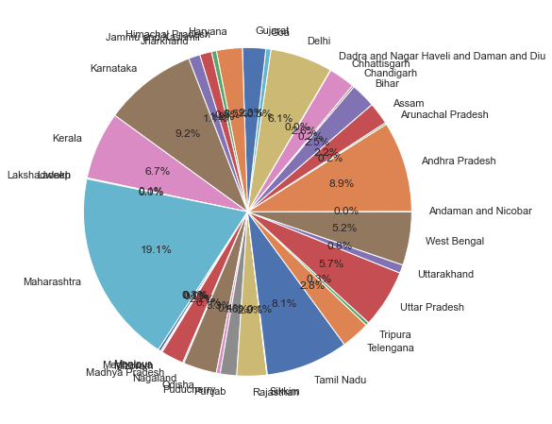
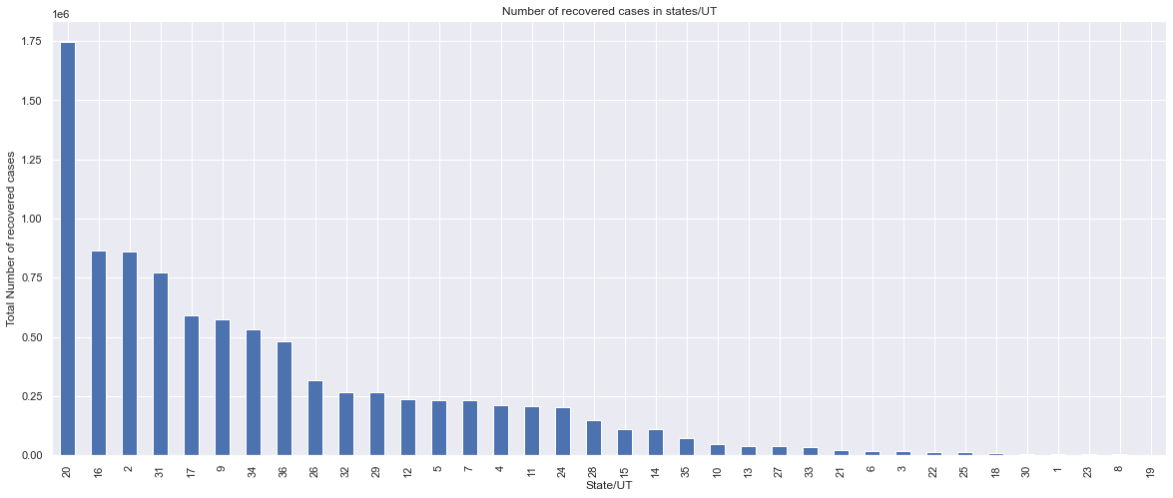
EXPERIMENTAL RESULTS
Fig.1 Illustrating total confirmed cases
Fig.2 Illustrating recovered cases in particular state

Slide 7
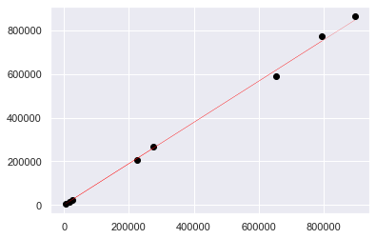
CONCLUSION
This is the final result of linear regression technique applied on the dataset. Here, line represents the predicted value and black circle represents the actual value.
As the figure shows, there is not much difference between actual and predicted value.
As this graph is between confirmed cases and recovered cases, we are able to analyse that recovery rate is nearly similar in all the states or U.T.

